Slide 1
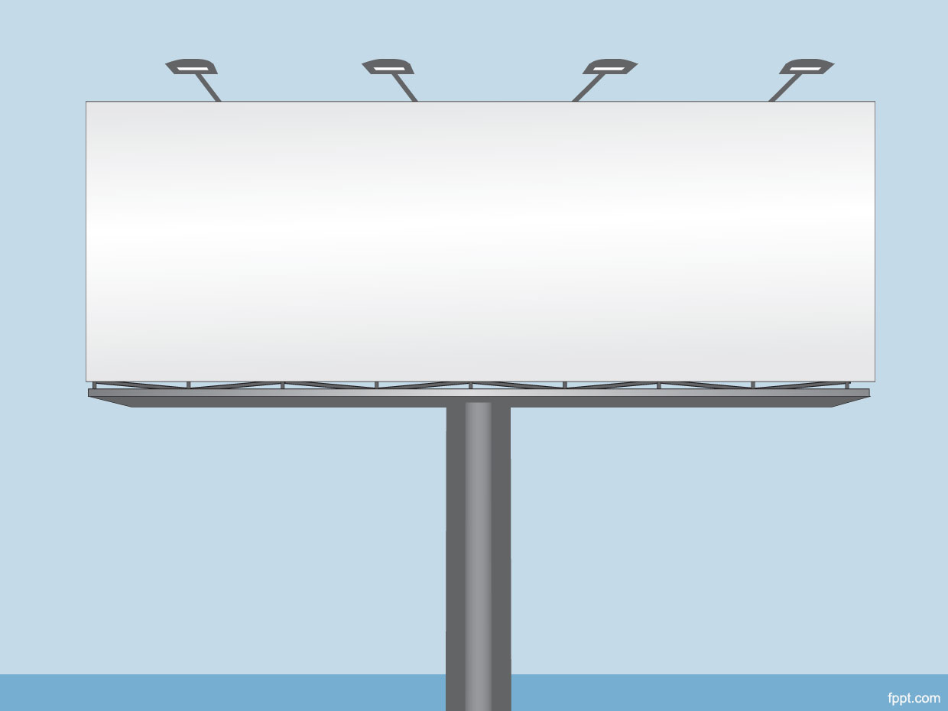
Third Party Signs and Traffic Accidents in Toronto
Shawn Mills
York University
CSDA1050
August 23, 2019

Slide 2
Introduction
Distracted driving is not a new phenomenon
Audible distractions
Music, passengers, horns, sirens, etc.
Visual distractions
Pedestrians, animals, advertisements, cell phones, etc.

Slide 3
Background
City of Toronto enacted its Sign By-law in 2010
Signage is divided into two categories:
First-party signs – identifies business or service at the location
Third-party signs – advertisements for goods or services not related to the business on premises
Permits are required for third-party signs

Slide 4
Literature Review
Other articles on distracted driving:
The role of roadside advertising signs in distracting drivers (https://www.researchgate.net/publication/222691471_The_role_of_roadside_advertising_signs_in_distracting_drivers)
Digital signage is a distracted driving hazard (https://www.myparkingsign.com/blog/digitalsignage-distracted-driving/)

Slide 5
Research Question
Does the presence of third-party signs affect the volume of traffic accidents in Toronto?

Slide 6
Data and Description
Third-party Signs Inventory (https://www.toronto.ca/city-government/data-researchmaps/open-data/open-data-catalogue/business/#9b6f952e-52d7-1fc4-51f6-4ad6bc913218 )
Toronto Police Service – Killed or Seriously Injured (KSI) Data (http://data.torontopolice.on.ca/datasets/ksi/data )
SimplyAnalytics – Census Tracts and Demographic Data (https://simplyanalytics.com/ )

Slide 7
Methodology
Geospatial analytics - determine location of signs relative to location of traffic accidents
Geospatial Autocorrelation used to uncover geographic relationships between signs and the number of traffic accidents
Visualizations and backing statistics

Slide 8
Python Environment
Python 3.5.8
Non-geographic libraries:
Pandas 0.25.0
Numpy 1.16.4
Xlrd 1.2.0
Visualization libraries:
Matplotlib 3.1.1
Seaborn 0.9.0

Slide 9
Python Environment (Continued)
Geographic and spatial libraries:
Geopandas 0.5.1
Shapely 1.6.4.post1
Fiona 1.8.4
Pycrs 1.0.1
Pysal 2.0.0

Slide 10
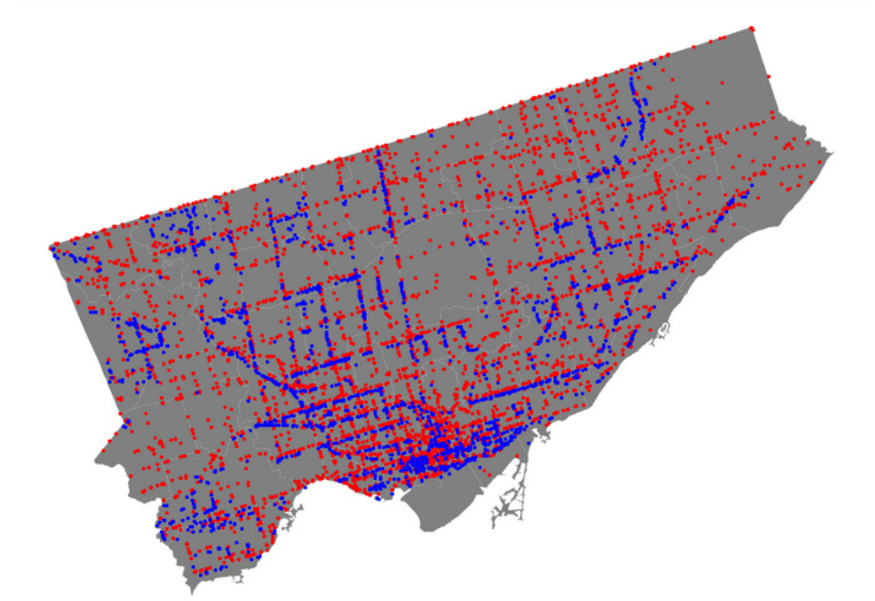
Locations of Signs and Accidents
Blue marks represent sign locations
Red marks represent accident locations
Overlapping of colours is evident
Large clustering exists in the south-central tracts

Slide 11
Question:
Is there a geospatial relationship to the location of the signs amongst themselves within the city?

Slide 12
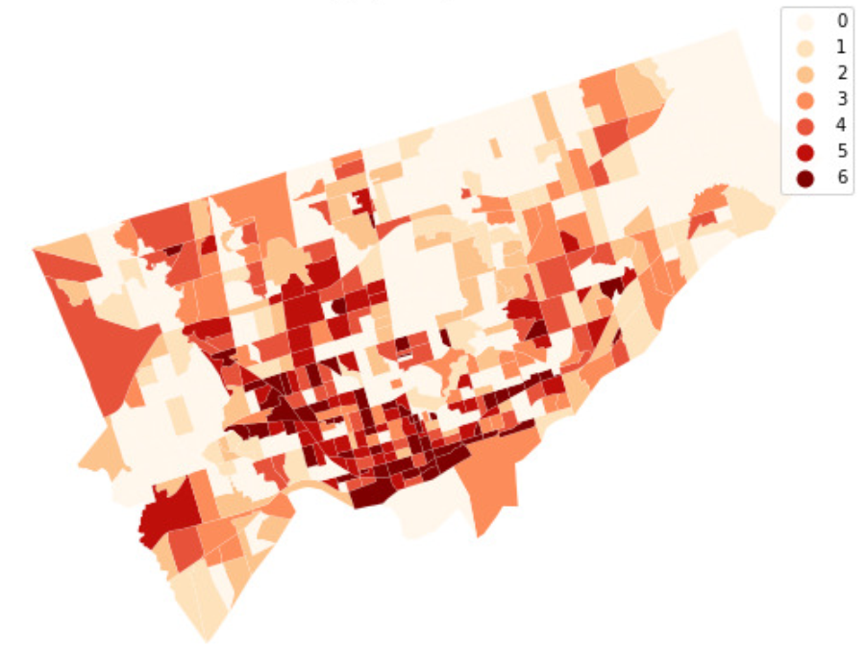
Signs per Square Km
Darker colours show tracts with greater density of signs per square Km

Slide 13
Spatial Autocorrelation
Displays clusters of similar regions based on a given feature or attribute
PySAL library provides the tools necessary to conduct spatial autocorrelation analysis

Slide 14
What is Similarity?
Spatial Similarity
spatial weights are used to determine which regions are neighbours (ie. neighbours are spatially similar)
Attribute Similarity
spatial lag is the measurement used to determine how similar a feature is between neighbouring regions

Slide 15
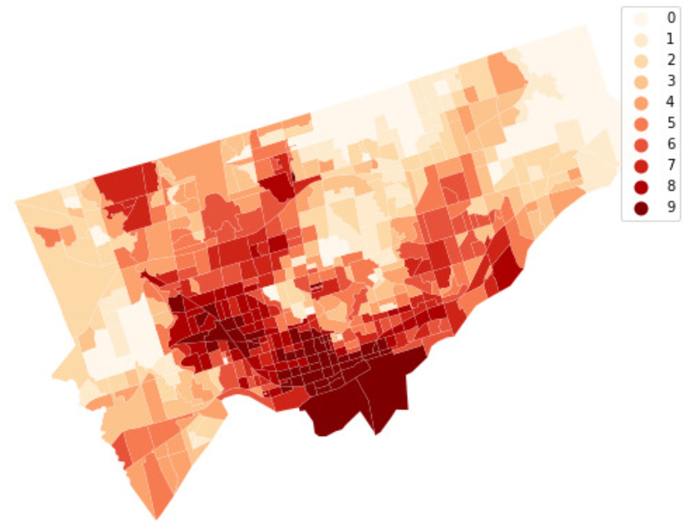
Spatial Autocorrelation Visualized
Spatial Lag of Signs per Square Km
Clustering appears in the south and upwards through the central-west tracts (darker)
Visually there appears to be some spatial correlation amongst the census tracts

Slide 16
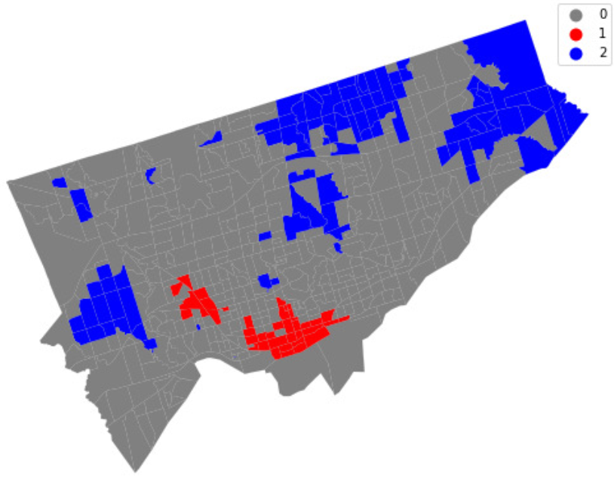
Local Indicators of Spatial Association (LISA) Visualized
Red clusters indicate significantly higher number of signs per square Km
Blue clusters indicate significantly lower number of signs per square Km

Slide 17
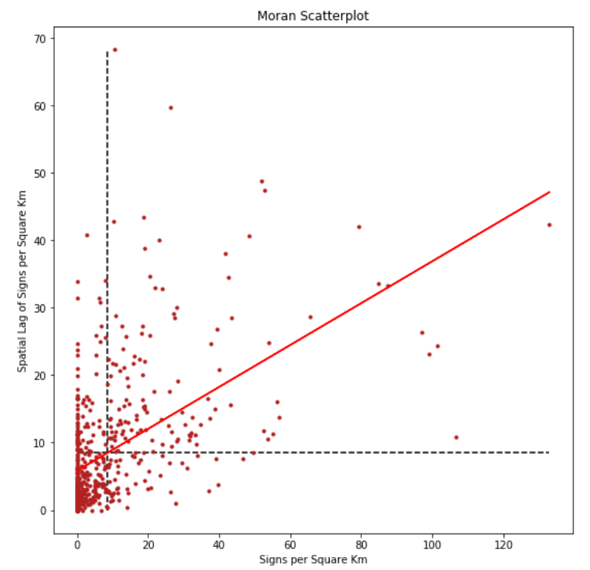
Moran Scatterplot
Scatterplot of Signs per Square Km vs. their spatial lag
Moran’s I value is shown as the red line
A positive relationship is visible

Slide 18
Statistical Results
Moran’s I = 0.31
since this is positive, there is some clustering of similar values
since this is somewhat close to zero, there may be some randomness to these values
p-value = 0.001
reject the null; I was not generated by chance

Slide 19
Question:
Is there a geospatial relationship to the location of the signs and the number of nearby traffic accidents?

Slide 20
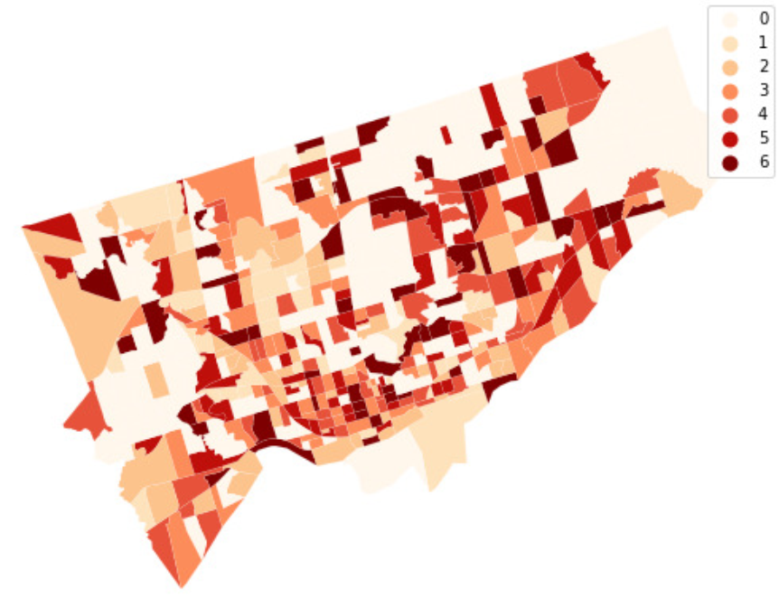
Accidents per Sign per Square Km
Darker colours show tracts with greater density of accidents per sign per square Km

Slide 21
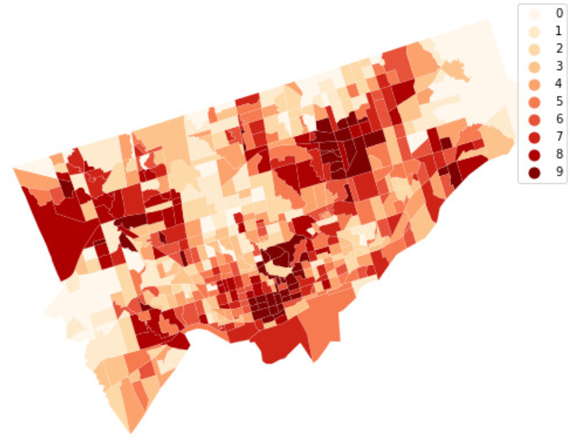
Spatial Autocorrelation Visualized
Spatial Lag of Accidents per Sign per Square Km
Clustering is visible, but appears to be more randomly dispersed across the city in comparison to the spatial lag map of the signs per square Km

Slide 22
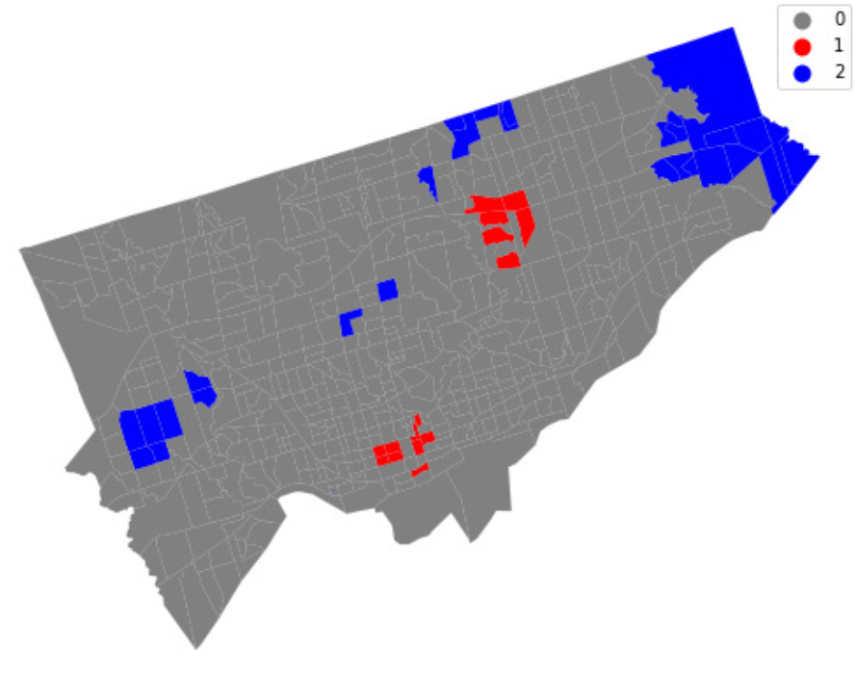
LISA Visualized
Red clusters indicate significantly higher number of accidents per sign per square Km
Blue clusters indicate significantly lower number of accidents per sign per square Km

Slide 23
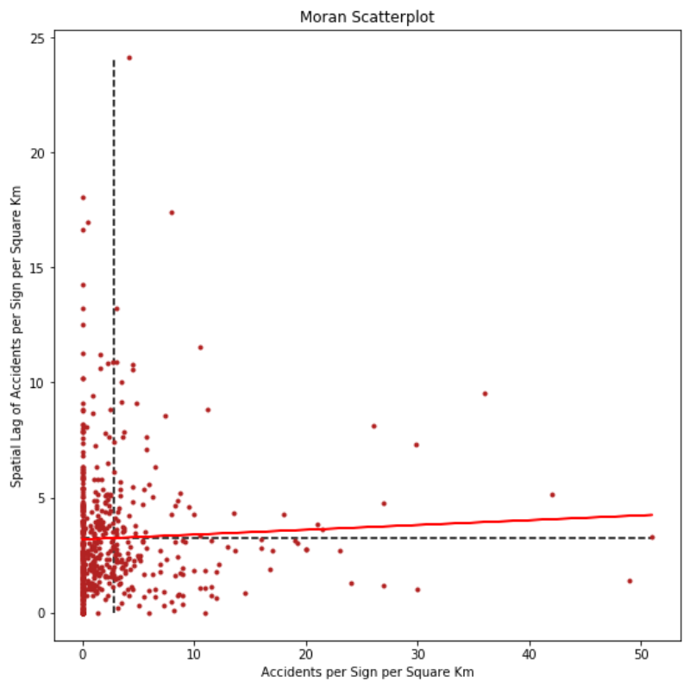
Moran Scatterplot
Scatterplot of Accidents per Sign per Square Km vs. their spatial lag
Moran’s I value is shown as the red line
A positive relationship is visible, but it is very weak

Slide 24
Statistical Results
Moran’s I = 0.02
since this is only barely positive, there is very little to no clustering of similar values
since this is almost zero, there is close to perfect randomness in these values
p-value = 0.181
Cannot reject the null; I could have generated by chance

Slide 25
Question:
Is there a demographic reason that could help explain this lack of relationship?
Most advertising signs (61.4%) are found in census tracts with above average population (AAP)
Check for a relationship in only these census tracts

Slide 26
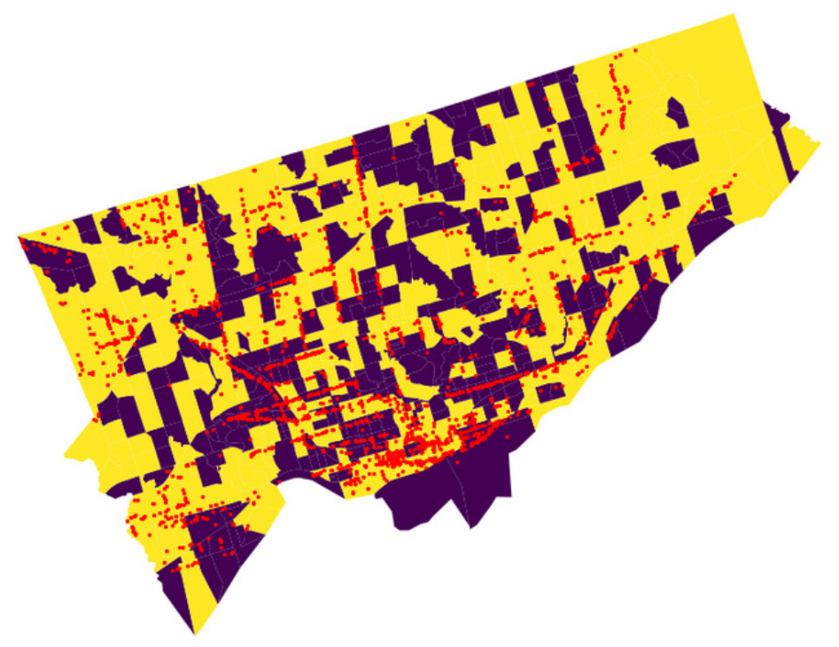
Sign Locations and Population
Sign locations are shown in red
Census tracts with above average population (AAP) are shown in yellow
Purple areas will be excluded

Slide 27
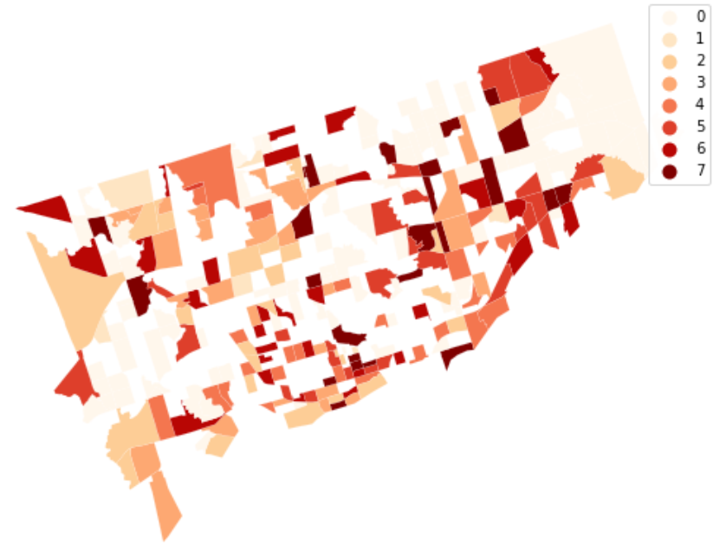
Accidents per Sign per Square Km - AAP Tracts Only
Darker colours show tracts with greater density of accidents per sign per square Km
Gaps between some census tracts represent areas below the average population

Slide 28
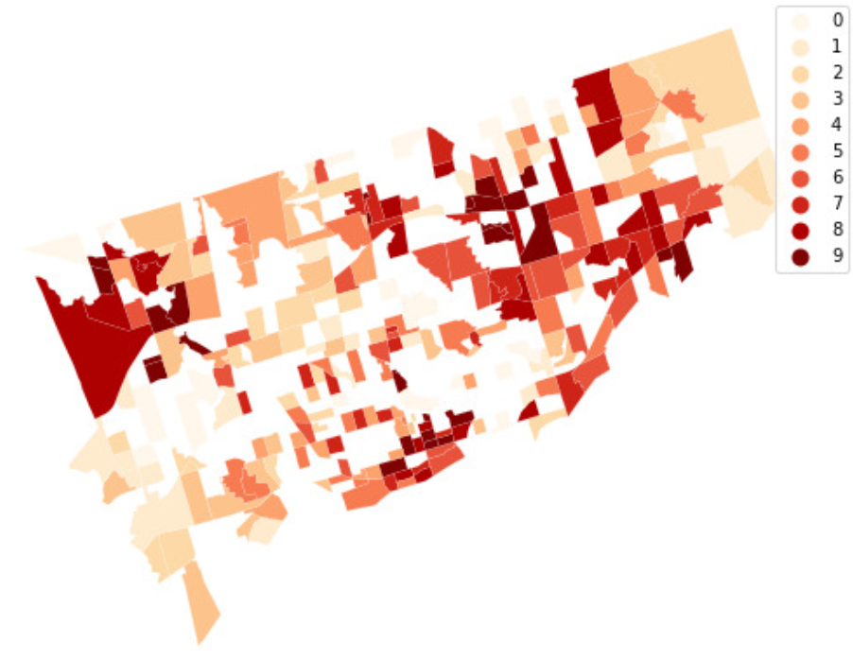
Spatial Autocorrelation Visualized
Spatial Lag of Accidents per Sign per Square Km in AAP Census Tracts
Similar results to the total spatial lag of accidents per square Km map
Clustering is visible, but appears to be randomly dispersed across the city

Slide 29
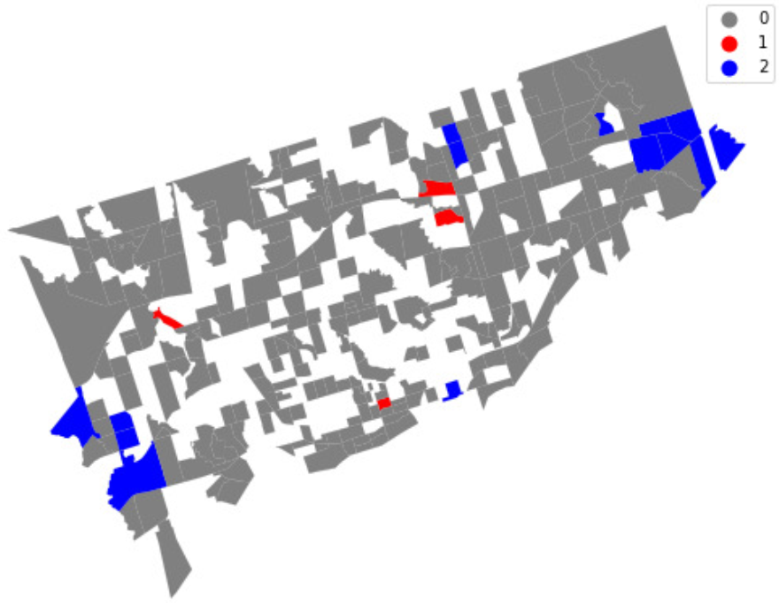
LISA Visualized
Red clusters indicate significantly higher number of accidents per sign per square Km in AAP census tracts
Blue clusters indicate significantly lower number of accidents per sign per square Km in AAP census tracts
Both appear randomly across the city

Slide 30
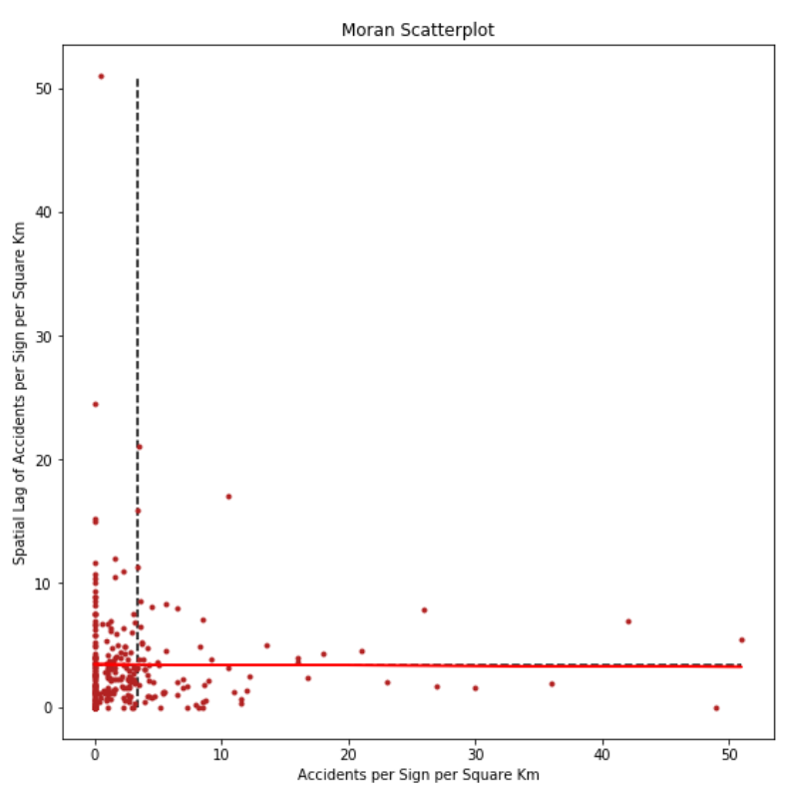
Moran Scatterplot
Scatterplot of Accidents per Sign per Square Km vs. their spatial lag in AAP census tracts
Moran’s I value is shown as the red line
No correlation appears to exist

Slide 31
Statistical Results
Moran’s I = -0.004
since this is almost zero, there is close to perfect randomness and no clustering in these values
p-value = 0.443
Cannot reject the null; I could have generated by chance
Much of the spatial similarity was lost by removing low population census tracts

Slide 32
Conclusion
There appears to be no correlation between the number of accidents and the presence of advertising signs in Toronto
The volume of accidents did not necessarily increase with the presence of more signs and no statistically significant relationship was found

Slide 33
Thank you
…and keep your eyes on the roads

